Slide 1
Chapter 10
Two-Sample Tests
Chap 10-<number>

Slide 2
Two-Sample Tests
Two-Sample Tests
Population Means, Independent Samples
Means, Related Samples
Examples:
Same population before vs. after treatment
Population 1 vs. independent Population 2
Chap 10-<number>

Slide 3
Hypothesis Tests for
Two Population Means
Two Population Means, Independent Samples
Lower-tail test:
H₀: μ₁ ≥ μ₂
H₁: μ₁ < μ₂
i.e.,
H₀: μ₁ – μ₂ ≥ 0
H₁: μ₁ – μ₂ < 0
Upper-tail test:
H₀: μ₁ ≤ μ₂
H₁: μ₁ > μ₂
i.e.,
H₀: μ₁ – μ₂ ≤ 0
H₁: μ₁ – μ₂ > 0
Two-tail test:
H₀: μ₁ = μ₂
H₁: μ₁ ≠ μ₂
i.e.,
H₀: μ₁ – μ₂ = 0
H₁: μ₁ – μ₂ ≠ 0
Chap 10-<number>

Slide 4
Hypothesis tests for μ₁ – μ₂
Two Population Means, Independent Samples
Lower-tail test:
H₀: μ₁ – μ₂ ≥ 0
H₁: μ₁ – μ₂ < 0
Upper-tail test:
H₀: μ₁ – μ₂ ≤ 0
H₁: μ₁ – μ₂ > 0
Two-tail test:
H₀: μ₁ – μ₂ = 0
H₁: μ₁ – μ₂ ≠ 0
α
α
α/2
α/2
-z_{α}
z_{α}
-z_{α/2}
z_{α/2}
Reject H₀ if Z < -Z_{α}
Reject H₀ if Z > Z_{α}
Reject H₀ if Z < -Z_{α/2}
or Z > Z_{α/2}
Chap 10-<number>

Slide 5
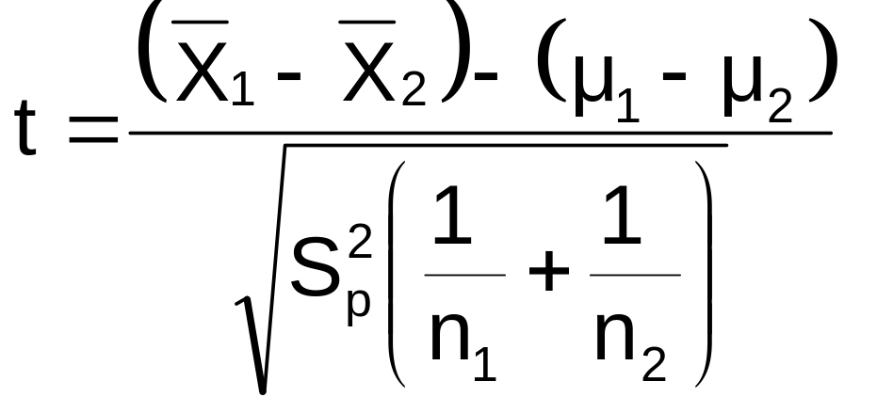
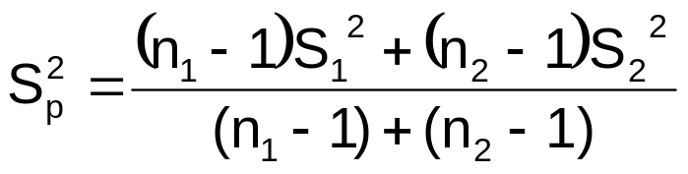
σ₁ and σ₂ Unknown,
Assumed Equal
(continued)
The test statistic for
μ₁ – μ₂ is:
Population means, independent samples
σ₁ and σ₂ known
*
σ₁ and σ₂ unknown, assumed equal
Where t has (n₁ + n₂ – 2) d.f.,
and
σ₁ and σ₂ unknown, not assumed equal
Chap 10-<number>

Slide 6

Pooled-Variance t Test: Example
You are a financial analyst for a brokerage firm. Is there a difference in dividend yield between stocks listed on the NYSE & NASDAQ? You collect the following data:
NYSE NASDAQ
Number 21 25
Sample mean 3.27 2.53
Sample std dev 1.30 1.16
Assuming both populations are
approximately normal with equal variances, is
there a difference in average
yield (α = 0.05)?
Chap 10-<number>

Slide 7
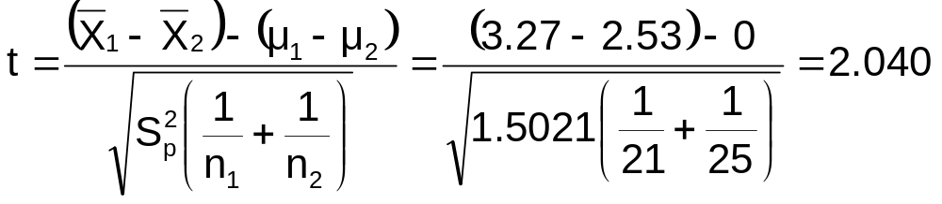
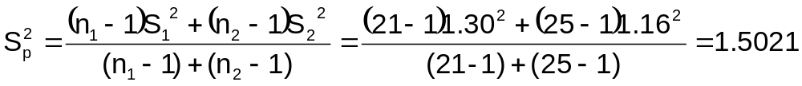
Calculating the Test Statistic
The test statistic is:
Chap 10-<number>

Slide 8
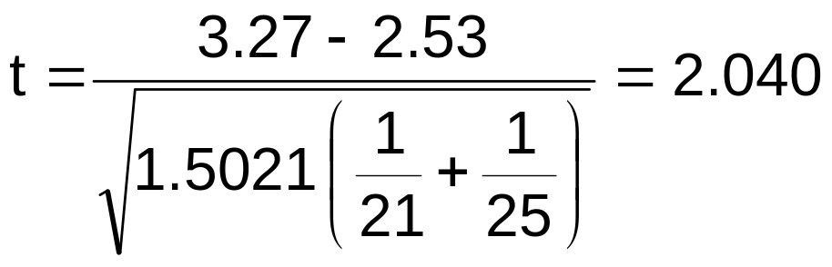
Solution
H₀: μ₁ - μ₂ = 0 i.e. (μ₁ = μ₂)
H₁: μ₁ - μ₂ ≠ 0 i.e. (μ₁ ≠ μ₂)
α = 0.05
df = 21 + 25 - 2 = 44
Critical Values: t = ± 2.0154
Test Statistic:
Reject H₀
Reject H₀
.025
.025
-2.0154
0
2.0154
t
2.040
Decision:
Conclusion:
Reject H₀ at α = 0.05
There is evidence of a difference in means.
Chap 10-<number>

Slide 9
Related Populations
Tests Means of 2 Related Populations
      Paired or matched samples
      Repeated measures (before/after)
      Use difference between paired values:
Eliminates Variation Among Subjects
Assumptions:
  Both Populations Are Normally Distributed
  Or, if not Normal, use large samples
Related samples
  D_{i} = X_{1i} - X_{2i}
Chap 10-<number>

Slide 10
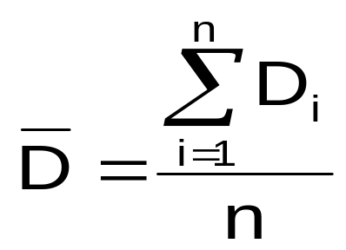
Mean Difference
The i^{th} paired difference is D_{i} , where
Related samples
  D_{i} = X_{1i} - X_{2i}
The point estimate for the population mean paired difference is D :
n is the number of pairs in the paired sample
Chap 10-<number>

Slide 11

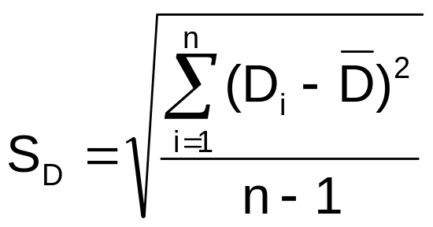
Mean Difference
Related samples
The sample standard deviation is
Chap 10-<number>

Slide 12
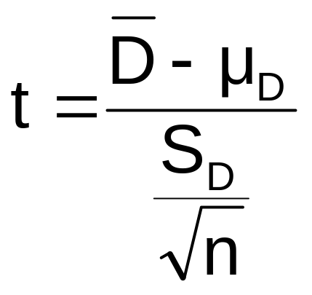
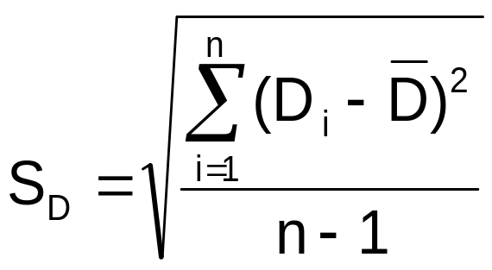
Mean Difference
(continued)
Use a paired t test, the test statistic for D is now a t statistic, with n-1 d.f.:
Paired samples
Where t has n - 1 d.f.
and S_{D} is:
Chap 10-<number>

Slide 13
Hypothesis Testing for
Mean Difference, σ_{D} Unknown
Paired Samples
Lower-tail test:
H₀: μ_{D} ≥ 0
H₁: μ_{D} < 0
Upper-tail test:
H₀: μ_{D} ≤ 0
H₁: μ_{D} > 0
Two-tail test:
H₀: μ_{D} = 0
H₁: μ_{D} ≠ 0
α
α
α/2
α/2
-t_{α}
t_{α}
-t_{α/2}
t_{α/2}
Reject H₀ if t < -t_{α}
Reject H₀ if t > t_{α}
Reject H₀ if t < -t_{α/2}
or t > t_{α/2}
Where t has n - 1 d.f.
Chap 10-<number>

Slide 14
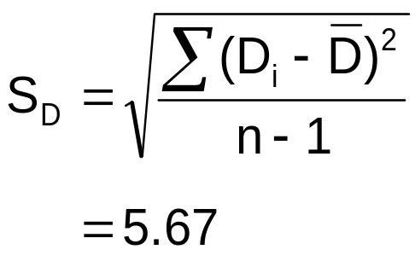
Paired t Test Example
Assume you send your salespeople to a “customer service” training workshop. Has the training made a difference in the number of complaints? You collect the following data:
Number of Complaints: (2) - (1)
Salesperson Before (1) After (2) Difference, D_{i}
C.B. 6 4 - 2
T.F. 20 6 -14
M.H. 3 2 - 1
R.K. 0 0 0
M.O. 4 0 - 4
-21
Σ
D_{i}
D =
n
= -4.2
Chap 10-<number>

Slide 15
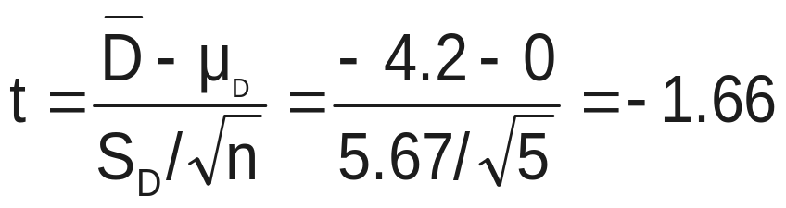
Paired t Test: Solution
Has the training made a difference in the number of complaints (at the 0.01 level)?
Reject
Reject
H₀: μ_{D} = 0
H₁: μ_{D} ≠ 0
α/2
α/2
α = .01
D =
- 4.2
- 4.604 4.604
- 1.66
Critical Value = ± 4.604 d.f. = n - 1 = 4
Decision: Do not reject H₀
(t stat is not in the reject region)
Test Statistic:
Conclusion: There is not a significant change in the number of complaints.
Chap 10-<number>

Slide 16
Two-Sample Tests in EXCEL
For independent samples:
Independent sample Z test with variances known:
  Tools | data analysis | z-test: two sample for means
Pooled variance t test:
  Tools | data analysis | t-test: two sample assuming equal variances
Separate-variance t test:
  Tools | data analysis | t-test: two sample assuming unequal variances
For paired samples (t test):
  Tools | data analysis | t-test: paired two sample for means
For variances:
F test for two variances:
  Tools | data analysis | F-test: two sample for variances
Chap 10-<number>

